Slide 1
AC Bluetooth Switch
Jorian Bruslind

Slide 2
Project Requirements
The final system may not include a breadboard.
The final system must must contain student designed PCB.
The system must be ruggedly enclosed as evaluated by the course instructor.
All wire connections to PCBs and going through the enclosure (entering or leaving) must use connectors
The system will turn off and on at least 2 independent household lamps with up to 100W incandescent bulbs and report current watts delivered by each channel.

Slide 3
Project Requirements
9 out of 10 users will be able to turn the switches off and on from a mobile phone in less than 10 seconds without any training or having previously seen the interface.
The system will use only US standard plugins for connecting to external devices and will not allow any object with a diameter greater than 1mm to enter the enclosure, and will be disable if more than 5A is drawn from the wall power.
The system must turn off the output after a time of upto 1 hour ± 1 minute when enabled.
The system will be able to accept commands from a mobile phone over 20 feet away from the plugins.

Slide 4
Custom Requirements
The system will have Wifi capabilities up to 10m away from a standard household router and will have a web interface that is accessible from a laptop/browser
The system will be waterproof up to the IP66 standard (splash resistance, not immersion resistant)

Slide 5
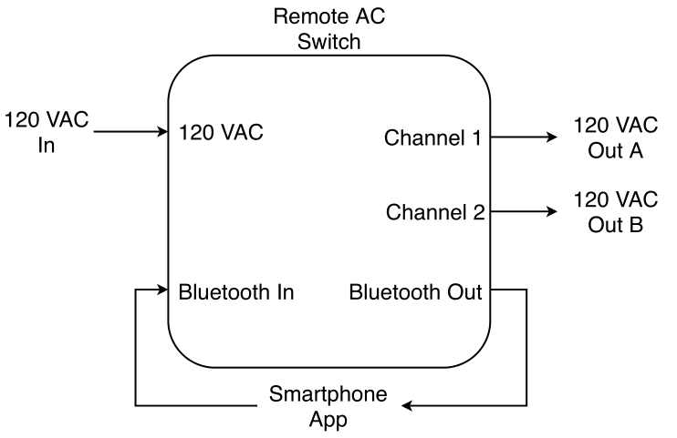
Block Diagram

Slide 6
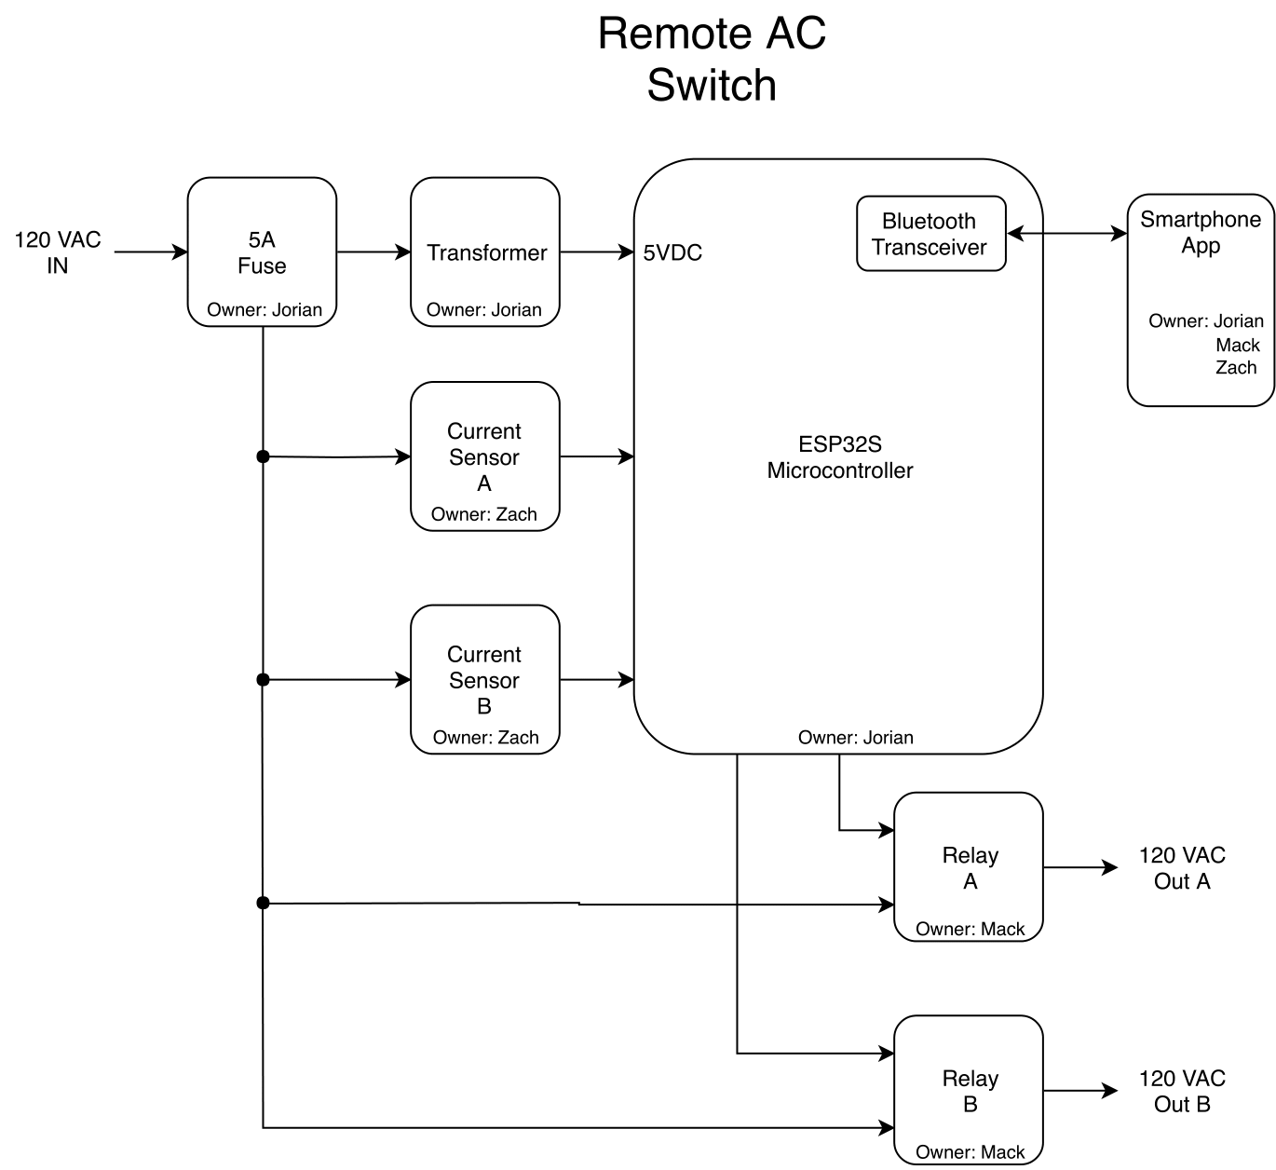
High Level Block Diagram

Slide 7
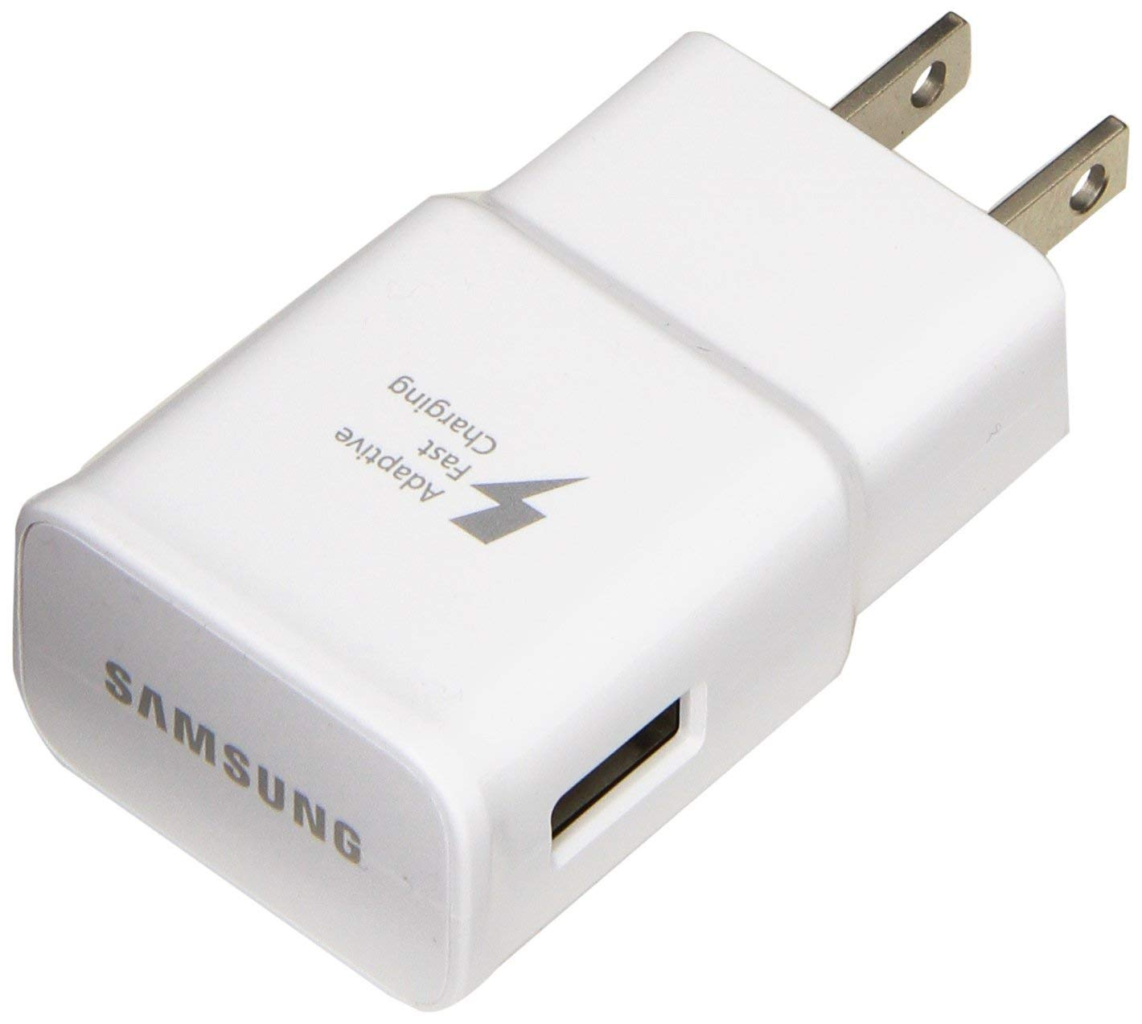
Block: Transformer
Utilize prebuilt technology
Samsung “Quick Charger” provides 5V@3.1A (max) from 120VAC input
Small form factor
Can be used with ESP32S

Slide 8
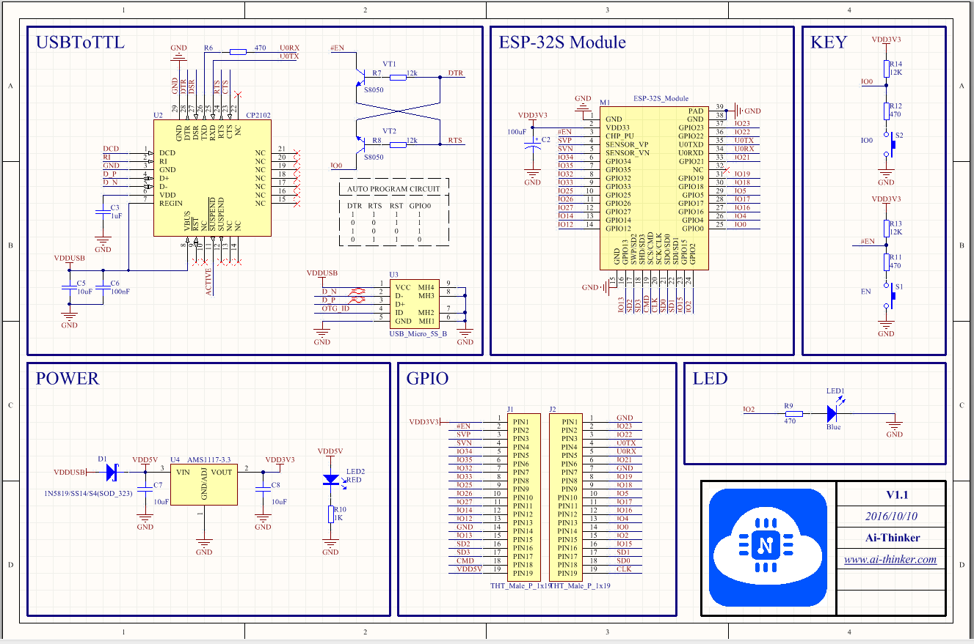
Block: ESP32S

Slide 9
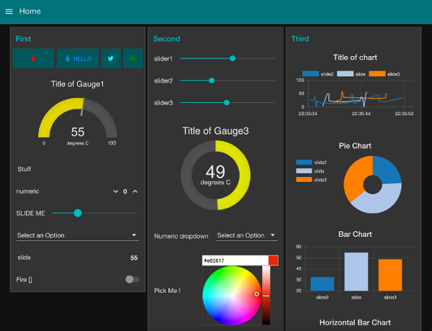
Wifi Integration
Use external software (Node Red)
Node JS Server integration with Local wifi messages
Use the MQTT protocol
Easy to use UI with MQTT integration

Slide 10
Questions

